Slide 1
Homework 8
Will Morgan

Slide 2
Make_2d.java
Make_2d takes three command-line arguments: the number of rows, the number of columns, and the name of the output file. Upon receiving these arguments, the program initializes a 2D array based on the provided dimensions, assigning 1.0 to boundary elements and 0.0 to interior elements. It creates a binary output stream to write the array data into the specified file. Exception handling is employed to address potential IO errors during file writing. It adds meta data to the binary file, being rows, cols, and frame. (Frame is set to 1)

Slide 3
Print_2d.java
Print_2d takes a single command-line argument, which should be the name of an input data file containing binary data representing a series of 2D frames. Upon receiving the file name, the program attempts to read it using a DataInputStream for binary input. It then extracts the number of rows, columns, and total frames from the file. It iterates through each frame, populating a 2D array with the corresponding data read from the file. For each frame, the program prints the 2D array to the console, formatting each value to display with two decimal places. In case of any IO exceptions, such as the file not being found, appropriate error handling is implemented to print the stack trace for diagnosis.

Slide 4
Stencil_2d.java
Stencil_2d executes a stencil computation algorithm on a 2D grid for a specified number of iterations. It takes four command-line arguments: the number of iterations, the file containing the initial state of the grid, the file where the final state of the grid will be saved, and the file where all intermediate frames of the computation will be stored. Upon receiving these arguments, the program reads the initial state from the input file, performs the stencil computation iteratively, and stores each intermediate frame in a 3D array. It measures the IO time for reading and writing data from/to files, as well as the computation time. Finally, it writes all frames to the specified output file and saves the final frame to another file. The program calculates the total execution time and prints it, along with the computation and IO times, to the console in seconds. If any IO exceptions occur during file operations, the program handles them by printing the stack trace for diagnosis.

Slide 5
Display_image.py
Display_image reads data from a Java program, which prints a 2D array, and then plot a heatmap of the data using Matplotlib in Python. The script takes the filename of the input data file for the Java program as a command-line argument. It first runs the Java program using subprocess.Popen to execute the Java code and capture its output. If the execution is successful, it extracts the printed array from the Java output and parses it into a list of lists containing float values. Then, the script plots the heatmap using Matplotlib's contourf function to create filled contours and contour function to overlay contour lines with corresponding values. It also adds a color bar to indicate the heatmap's color scale and adjusts axis labels and ticks for better readability. Finally, it displays the generated heatmap plot. The script uses argparse to parse command-line arguments and provides usage instructions if incorrect arguments are provided.

Slide 6
Gather_data.py
Gather_data automates the process of running a series of Java programs with varying input parameters and capturing their output to a specified file. It takes four arguments: N, M, iterations, and output_file. The function iterates through a range of values from N to M, inclusive, and for each value, it first runs a Java program called "make_2d" with parameters N and M to create input data. Then, it executes another Java program named "stencil_2d" with the provided number of iterations, using the input data generated previously. The function captures the command line output of "stencil_2d" and writes it to the output file along with the current value of N. If an error occurs during the execution of "stencil_2d" for any value of N, it prints an error message and exits the program. The script also ensures that the correct number of command line arguments are provided when running the script directly.

Slide 7
Plot_data.py
Plot_data generates a line plot from data stored in a specified file and saves the plot as a PNG image. It takes two arguments: data_file, which is the path to the file containing the data to be plotted, and output_png, which is the filename for the PNG image to be generated. The function reads the data from the file, skipping the header line, and parses each line to extract the values representing different aspects of time. These values are stored in separate lists for N (the x-axis), total time (T), work time (T_W), and IO time (T_IO). Using Matplotlib, the function plots these lists against N, labeling each line appropriately. It also sets the axes labels and title for the plot, adds a legend, and enables a grid for better visualization. Finally, it saves the plot as a PNG file with the specified filename and displays the plot to the user. Additionally, the script ensures that the correct number of command line arguments is provided when running the script directly, providing usage instructions if incorrect.

Slide 8
Generate_movie.py
Generate_movie.py, creates a movie from a series of frames representing heatmap data generated by a Java program (print_2d). It takes two command-line arguments: the file containing all the frames and the desired output file for the movie. The script first runs the Java program using subprocess to extract the heatmap data for each frame. Then, it generates a sequence of heatmap plots using Matplotlib based on the extracted data. These plots are saved as individual images in PNG format. Afterward, the script utilizes ImageIO to create a GIF from the saved images, thus producing a movie representation of the heatmap data. Finally, it cleans up the temporary image files.

Slide 9
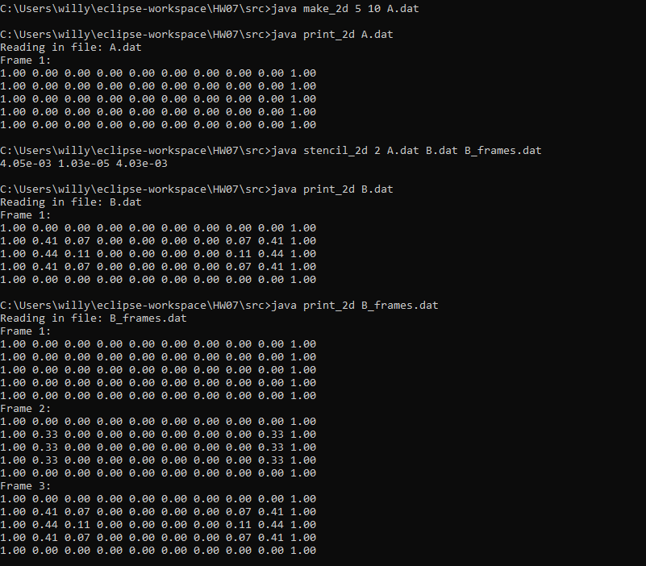
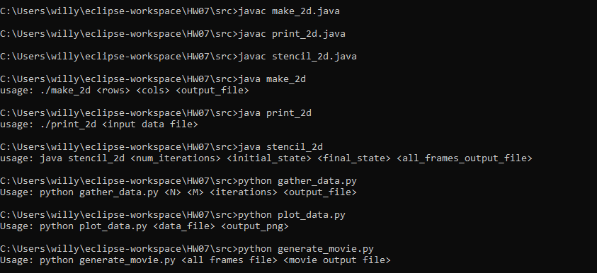
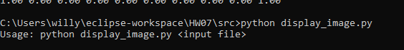
Usage and execution

Slide 10
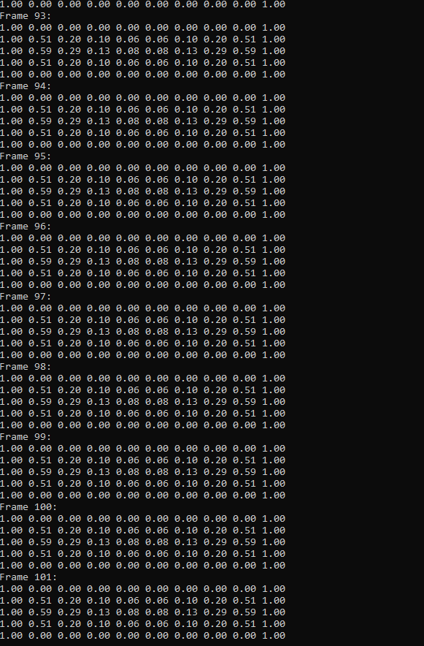
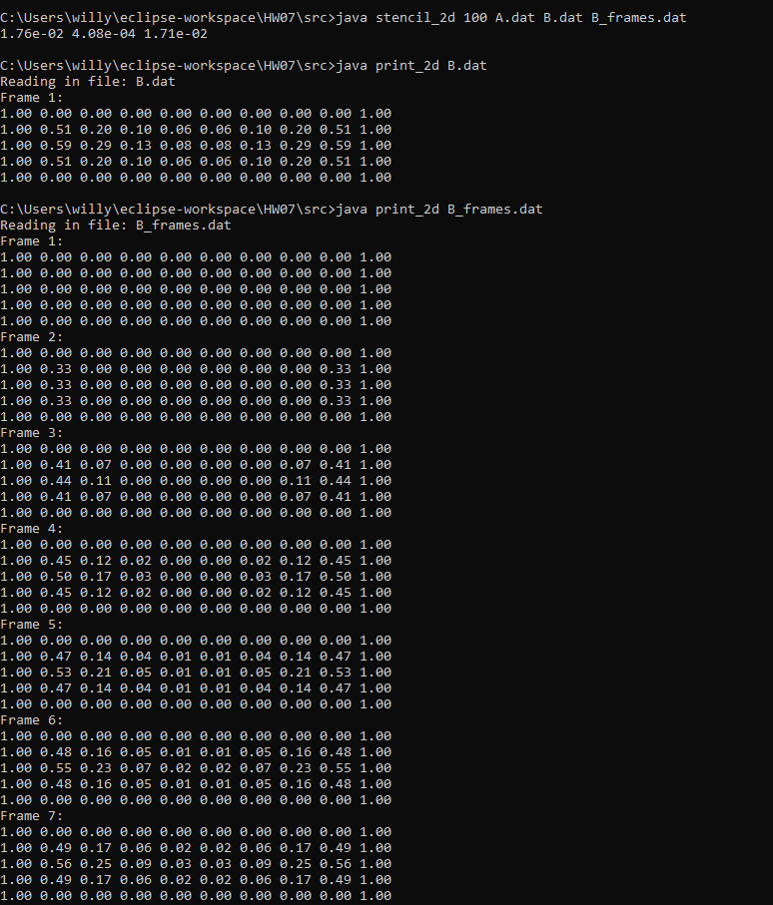
Usage and execution cont.

Slide 11
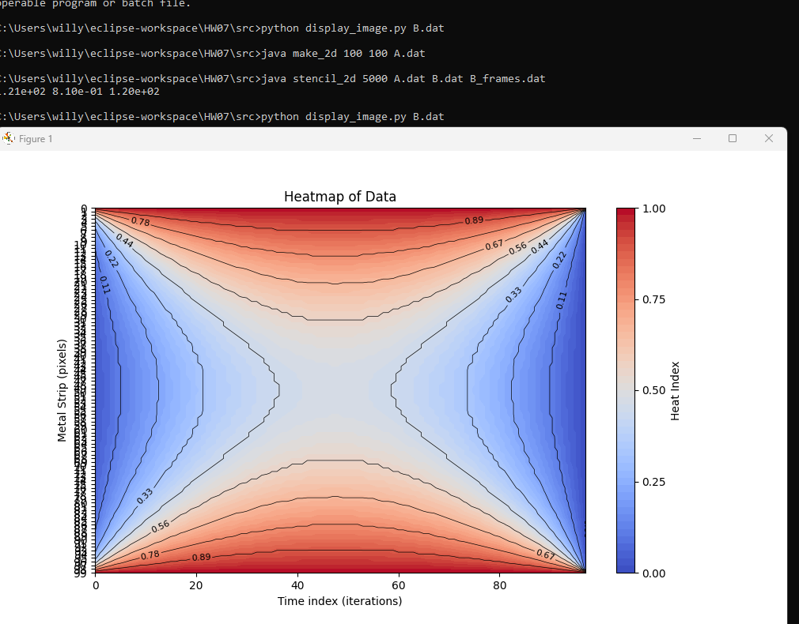
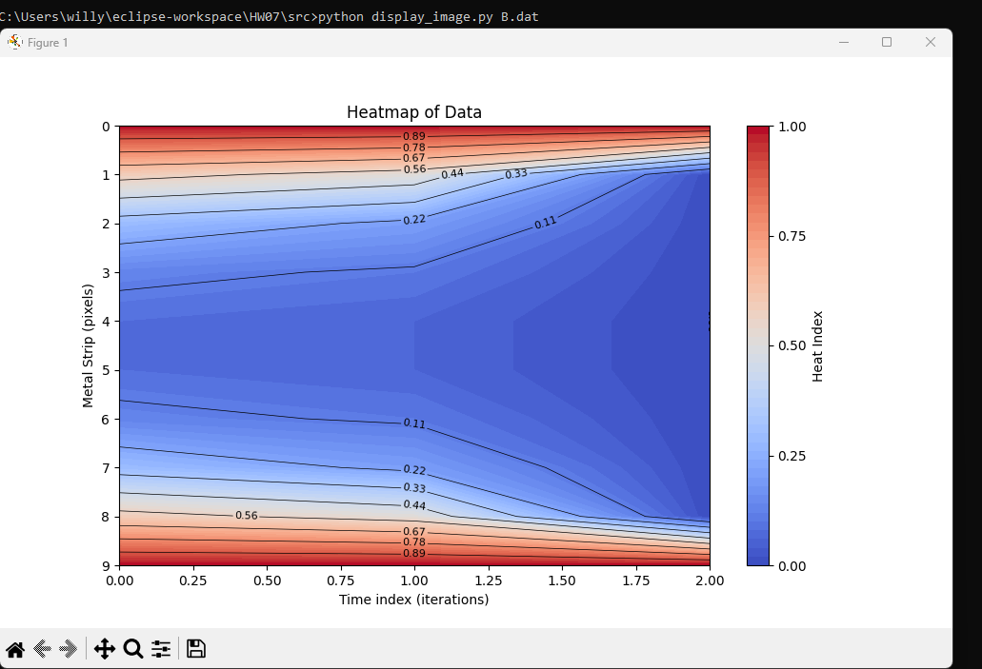
Heatmap of 100x100 5000 iterations (y axis is 0-99)
Heatmap of 5x10 100 iterations

Slide 12
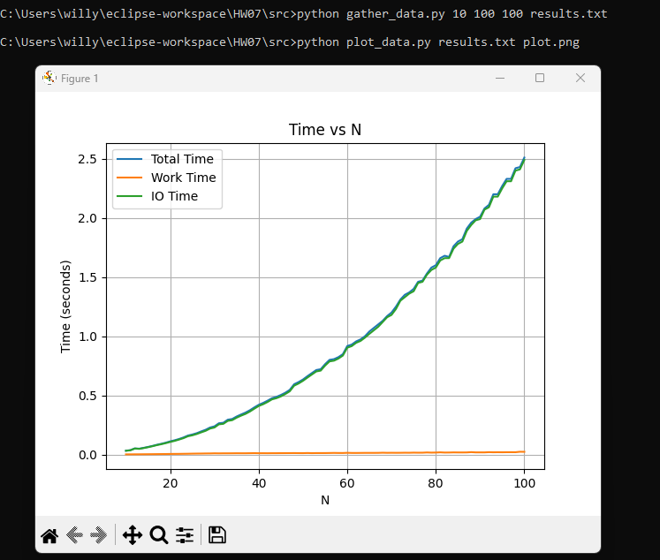
Plot of Total time, work time and IO time for the stencil_2d class. Gather data is gathering array sizes NxN to M. In this example, 10x10 to 100x100, then it plots the time it takes for each execution.

Slide 13
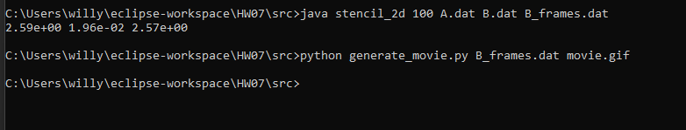
Generate_movie.py
Note: This function will start by saving all of the images on your computer, but after everything is done they will all be deleted and turned into a gif EXAMPLE IN NEXT SLIDE

Slide 14
